Slide 1
PROJECT TITLE
AD4V71 - Machine Learning Operations (MLOps)
Intelligent Movie Recommendation SystemUsing User Preferences
Presenting By
Team Member 1 Name : Jason Thomas
Team Member 1 Regd No. : 24AD0110
Team Member 1 Section : C
Team Member 2 Name : Bobby Anderson
Team Member 2 Regd No. : 24AD0106
Team Member 2 Section : C

Slide 2
Problem Identification and Title Justification
Relevance of the Problem-
Users struggle to find movies matching their interests.
Large content libraries make manual searching difficult.
Personalized recommendations improve user experience.
Clarity of Problem Statement-
Build a movie recommendation system using machine learning.
Use MLOps to automate deployment, monitoring, and retraining.
Justification of Project Title & Scope-
Combines AI-based recommendations with MLOps practices.
Covers data processing, model training, deployment, and maintenance.
Aims to deliver accurate and up-to-date movie suggestions.

Slide 3
Basic Concepts
Machine Learning (ML): Learns user preferences from ratings and watch history.
Recommendation System: Suggests movies based on similar users or content.
MLOps: Automates model training, deployment, monitoring, and updates.
Data Pipeline: Collects and preprocesses movie and user data.
Model Deployment: Makes recommendations available through an applicationor API.
Continuous Monitoring: Tracks performance and retrains the model with newdata.

Slide 4
Literature Survey
Existing Project/System
 | Advantages | Disadvantages
Netflix Recommendation System | Highly personalized recommendations | Requires massive user data
IMDb Recommendation Engine | Uses ratings and popularity effectively | Less personalized for new users
Content-Based Filtering | Recommends similar movies by genre and features | Limited diversity in suggestions
Collaborative Filtering | Learns from users with similar preferences | Suffers from the cold-start problem
Hybrid Recommendation System | Combines multiple techniques for better accuracy | More complex to implement and maintain
Research Gap-
Existing systems struggle with new users and new movies.
Many recommendation models lack continuous monitoring and retraining.
MLOps helps keep recommendations accurate and up to date.

Slide 5
Objectives of the Project
Develop a personalized movie recommendation system using machinelearning.
Recommend movies based on user preferences and viewing history.
Implement MLOps practices for automated deployment and monitoring.
Continuously retrain the model with new user data to improve accuracy.
Provide fast, scalable, and reliable recommendations.

Slide 6
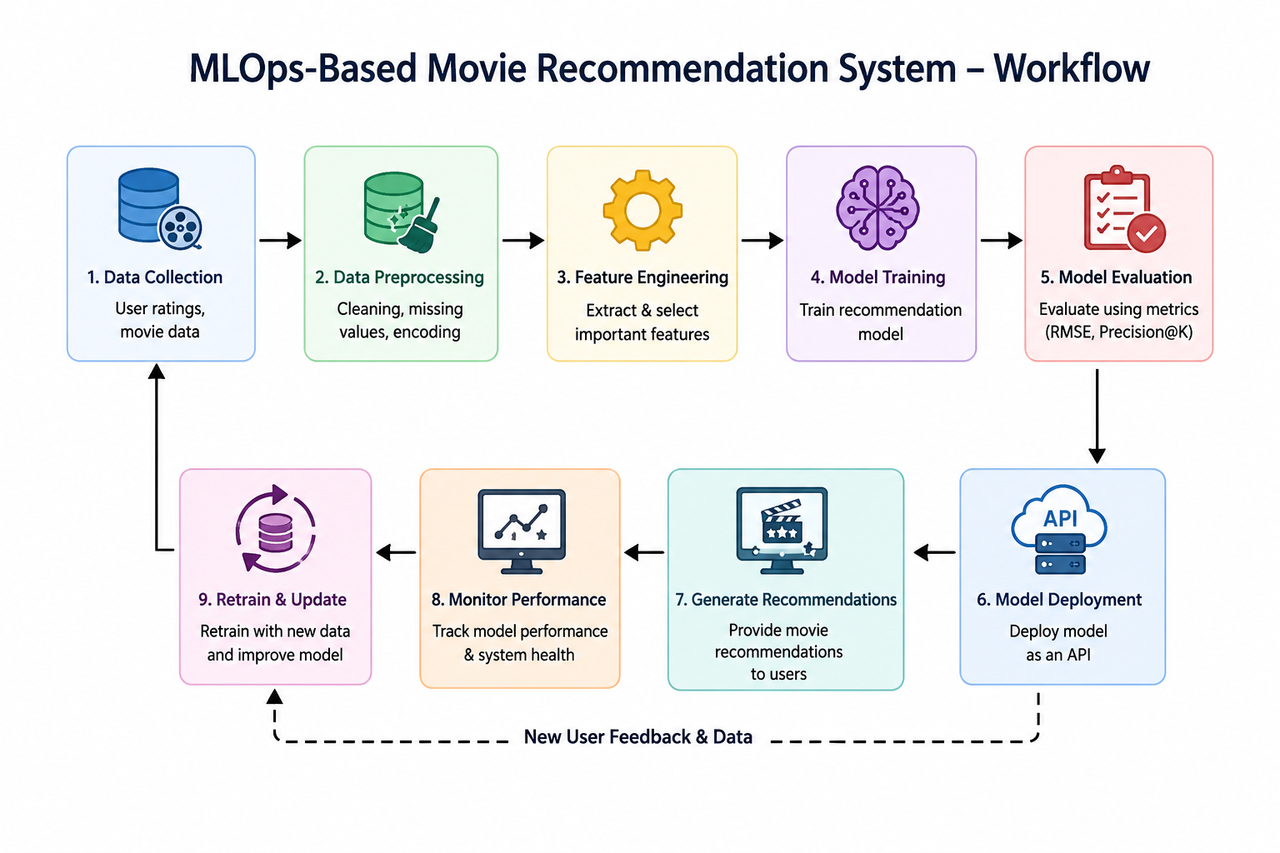

Slide 7
Project Planning and Time Schedule
Week | Task
Week 1 | Data Collection & Requirement Analysis
Week 2 | Data Preprocessing & Exploration
Week 3 | Model Development & Training
Week 4 | Model Deployment using MLOps
Week 5 | Testing, Monitoring & Retraining
Week 6 | Documentation & Final Presentation
Task Allocation-
Member 1: Data collection, preprocessing, and model training.
Member 2: Deployment, monitoring, testing, and documentation.
Milestones-
Complete dataset preparation.
Train and evaluate the recommendation model.
Deploy the model and set up monitoring.
Finalize the project and presentation.

Slide 8
Exploratory Data Analysis
Dataset Overview
Key Findings
Important Features
Dataset Used:
MovieLens Latest Dataset
TMDb Movie Metadata (optional)
User ratings and movie information
Features Include:
User ID & Movie ID
Movie title & genres
User ratings (1–5)
Timestamp of ratings
Majority of users rate movies between 3 and 5 stars.
Drama, Action, and Comedy are the most popular genres.
Some movies have significantly more ratings than others.
Missing values and duplicate records were cleaned during preprocessi
Strong Predictors
User rating history
Favorite genres
Similar user preferences
Movie popularity
Weak Predictors
Movie release year
Timestamp alone
Dataset Statistics
Thousands of movies
Millions of user ratings
Multiple movie genres

Slide 9
Data Preprocessing
✅
Missing Value Handling
Removed missing or incomplete rating records.
Filled missing movie metadata where applicable.
✅
Duplicate Removal
Removed duplicate user ratings and movie entries.
Ensured dataset consistency before training.
✅
Normalisation
Scaled numerical features such as user ratings.
Standardized data for better model performance.
✅
Feature Extraction
Extracted useful features:
User rating history
Movie genres
Movie popularity
Average movie rating
🔄
Feature Validation(In Progress)
Verifying feature quality and correlation.
Preparing the final dataset for model training.
Output → Cleaned feature matrix ready for model training (n_samples × 8 features)

Slide 10
Progress Timeline
✅ Complete
🔄 In Progress
⬜ Upcoming
Phase
W1
W2
W3
W4
W5
W6
W7
W8
W9
W10
▼ NOW
✅ P1: Literature Review
✅ P2: Data Collection
✅ P3: Preprocessing
🔄 P4: Model Training
⬜ P5:Application Development
⬜ P6: Evaluation & Docs
Data Collection
✅ Done
Preprocessing
✅ Done
Model Training
🔄 Started
Routing Engine
⬜ Pending
Evaluation
⬜ Pending

Slide 11
References
Ricci, F., Rokach, L., & Shapira, B. Recommender Systems Handbook. Springer.
Goodfellow, I., Bengio, Y., & Courville, A. Deep Learning. MIT Press.
Géron, A. Hands-On Machine Learning with Scikit-Learn, Keras & TensorFlow. O'Reilly Media.
MovieLens Dataset – https://grouplens.org/datasets/movielens/
MLflow Documentation – https://mlflow.org/docs/latest/

Slide 12
Thank You!

